Slide 1
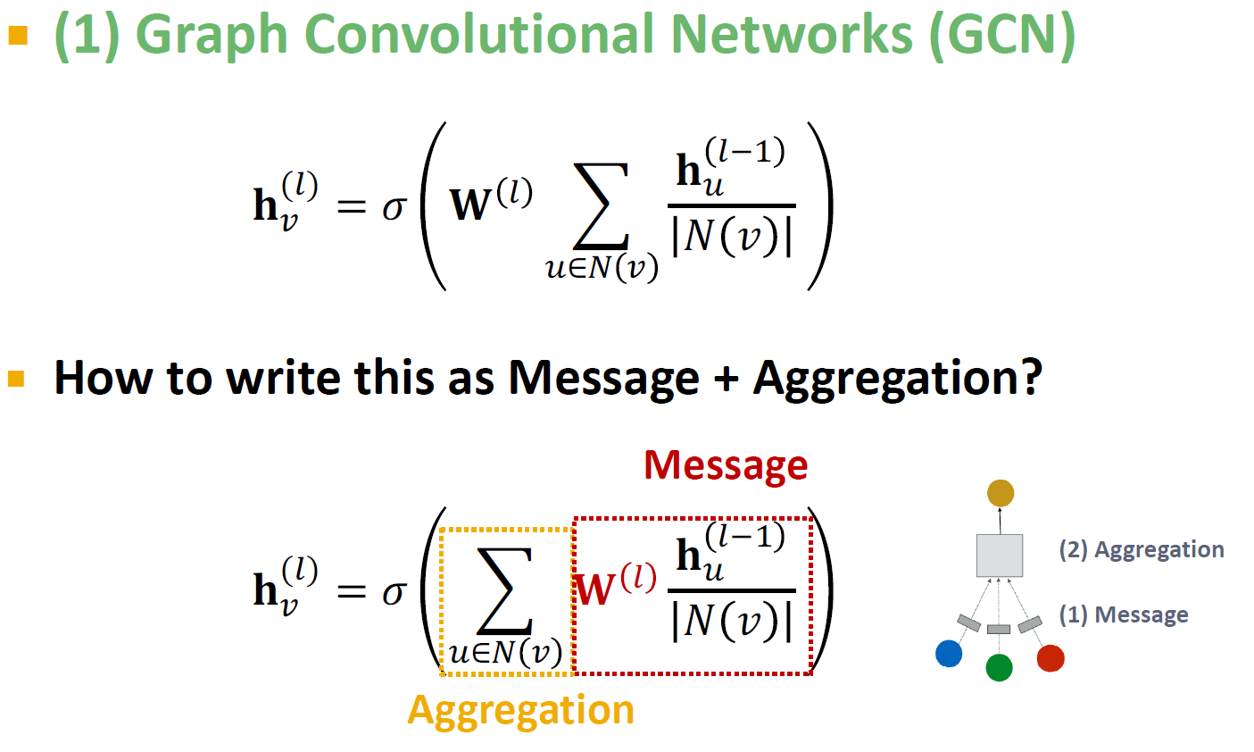
T. Kipf, M. Welling. Semi-Supervised Classification with Graph Convolutional Networks, ICLR 2017

Slide 2
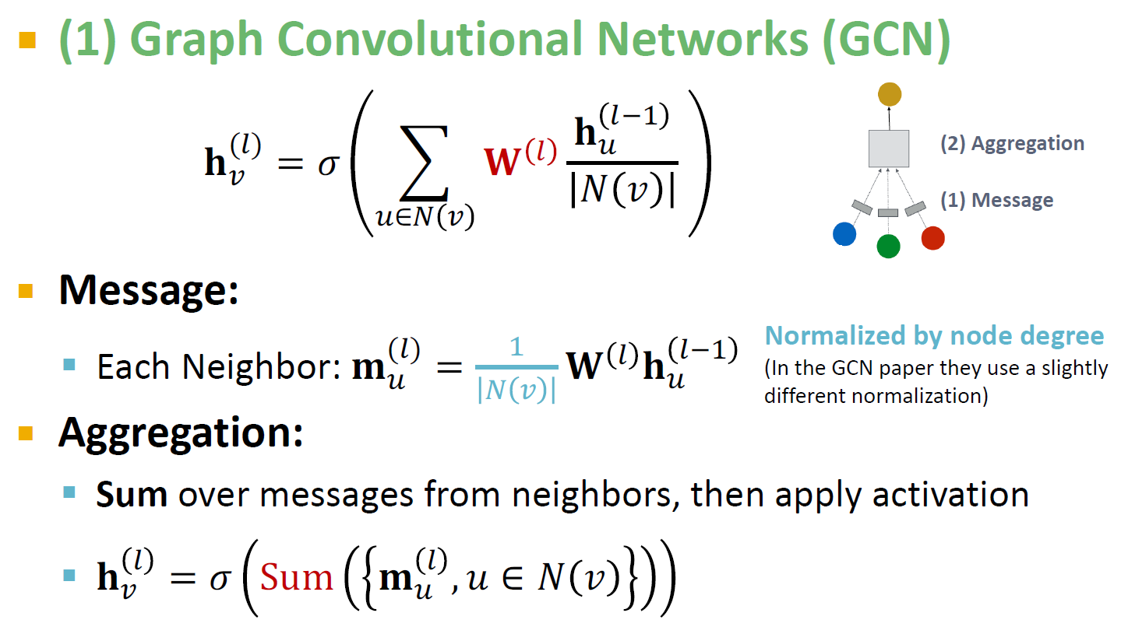

Slide 3
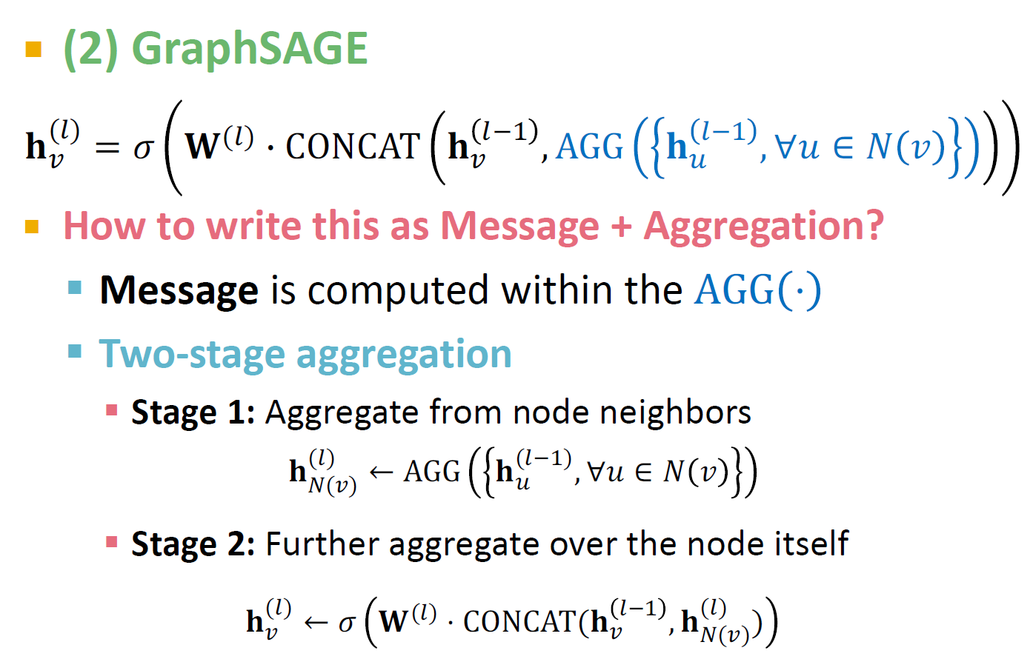
Hamilton et al. Inductive Representation Learning on Large Graphs, NeurIPS 2017

Slide 4
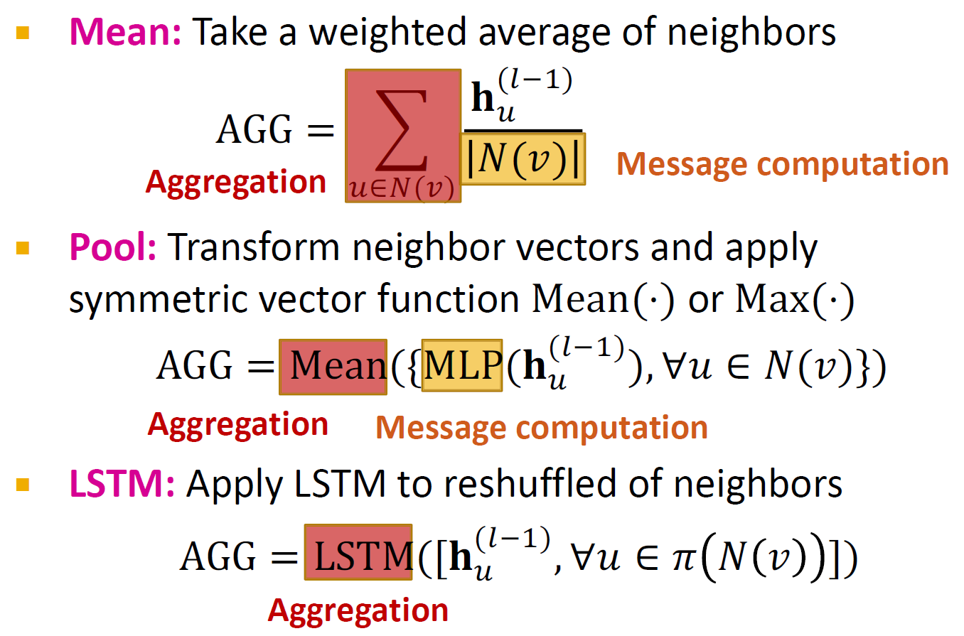

Slide 5
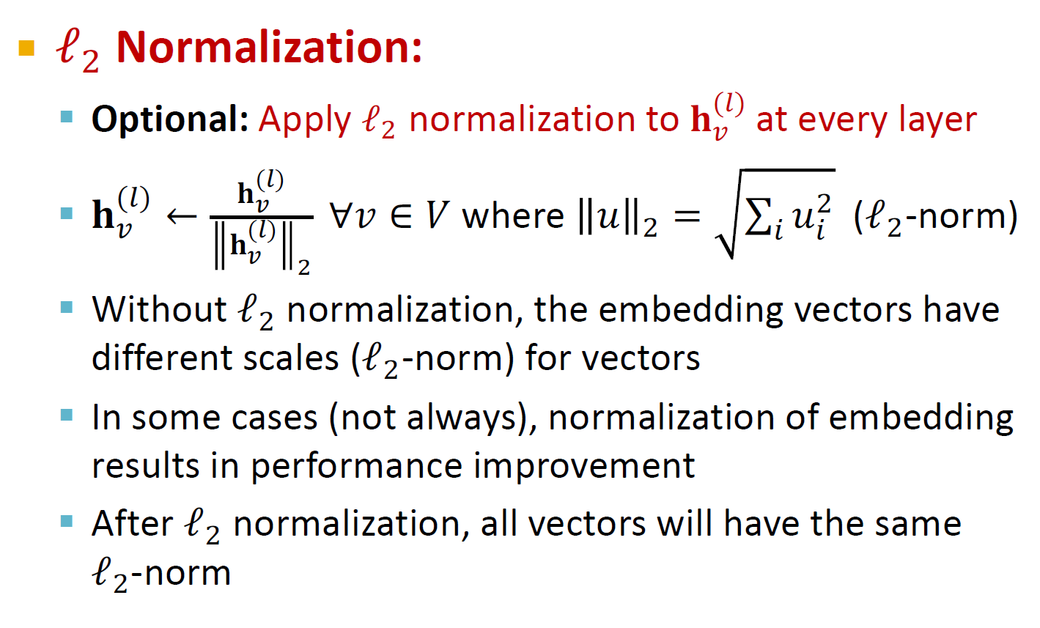

Slide 6
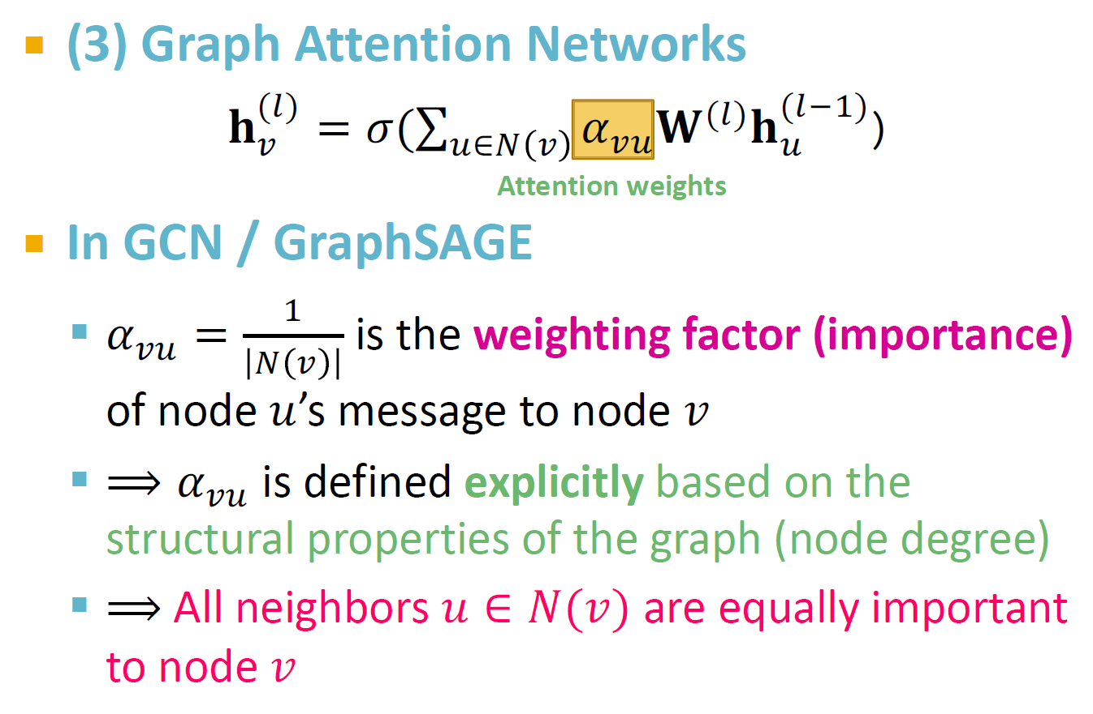

Slide 7
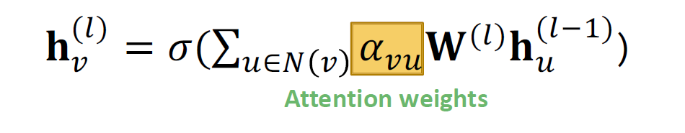
(3) Graph Attention Networks
Not all node’s neighbors are equally important
Attention is inspired by cognitive attention.
The attention 𝜶_{𝒗𝒖} focuses on the important parts of the input data and fades out the rest.
Idea: the NN should devote more computing power on that small but important part of the data.
Which part of the data is more important depends on the context and is learned through training.

Slide 8
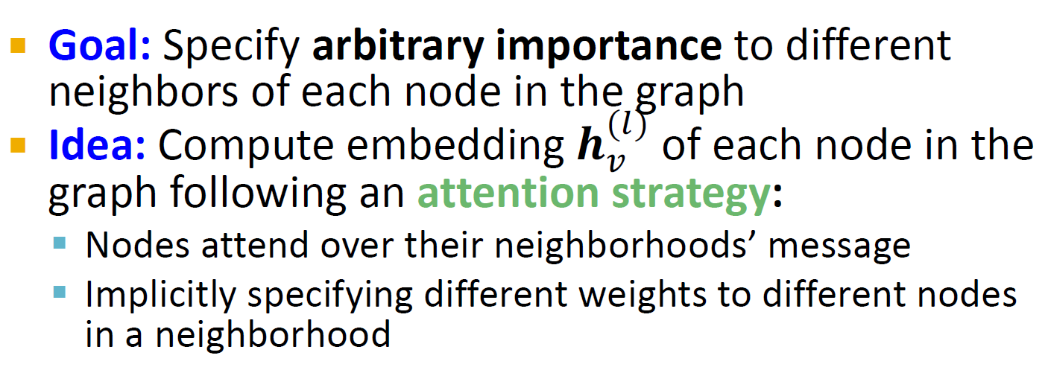
Can we do better than simple neighborhood aggregation?
[Velickovic et al., ICLR 2018; Vaswani et al., NIPS 2017]
Can we let weighting factors 𝜶_{𝒗𝒖} to be learned?

Slide 9
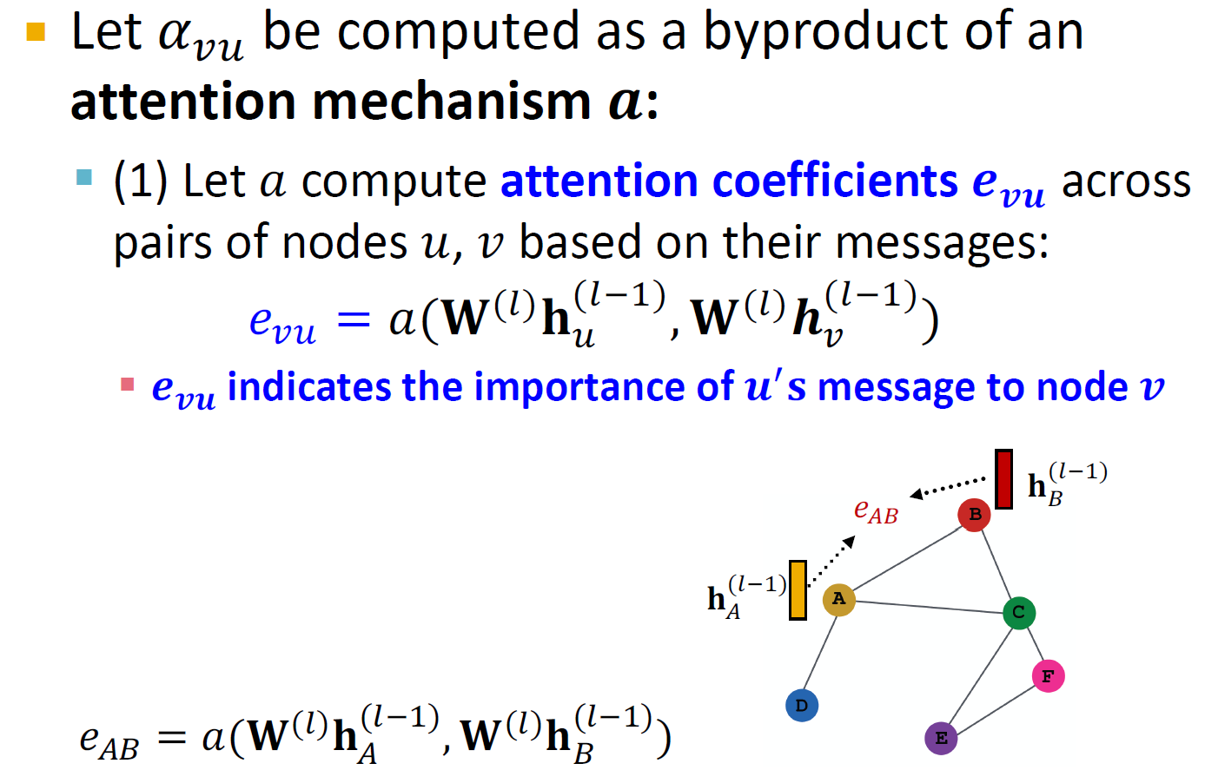

Slide 10
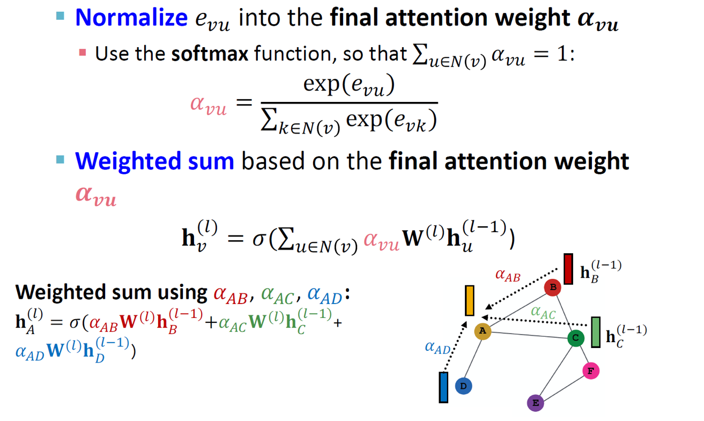

Slide 11
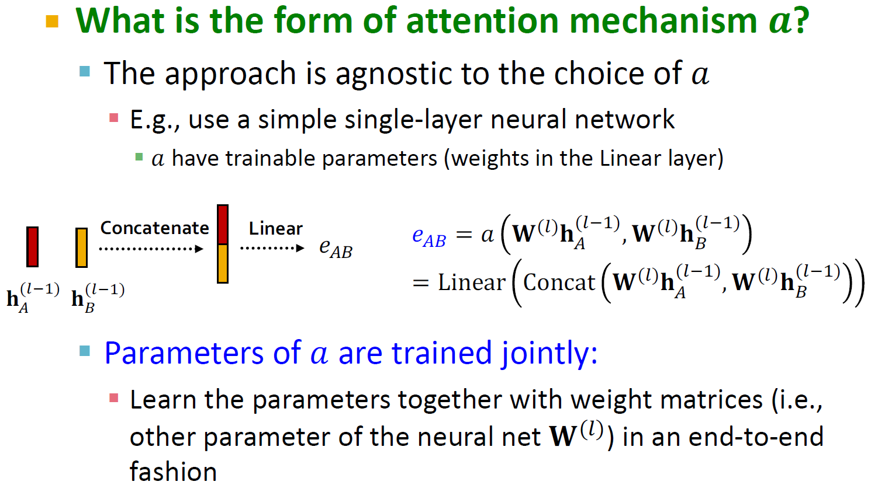

Slide 12
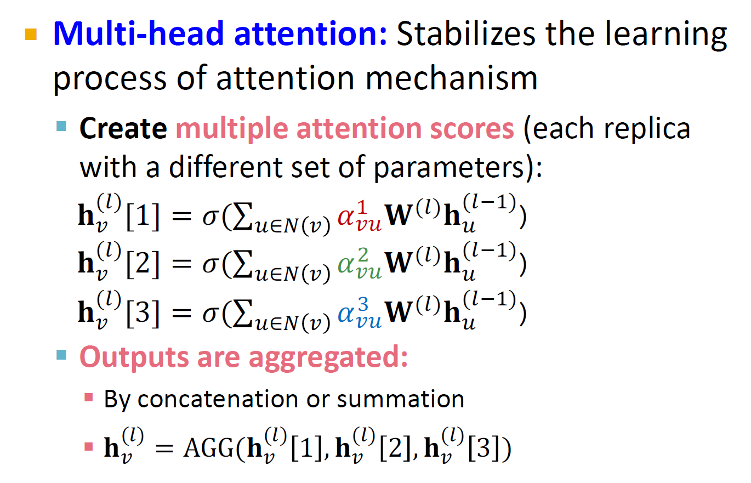

Slide 13
Key benefit: Allows for (implicitly) specifying different importance values (𝜶_{𝒗𝒖}) to different neighbors
Computationally efficient:
Computation of attentional coefficients can be parallelized across all edges of the graph
Aggregation may be parallelized across all nodes
Storage efficient:
Sparse matrix operations do not require more than
𝑂(𝑉 + 𝐸) entries to be stored
Fixed number of parameters, irrespective of graph size
Localized:
Only attends over local network neighborhoods
Inductive capability:
It is a shared edge-wise mechanism
It does not depend on the global graph structure

Slide 14
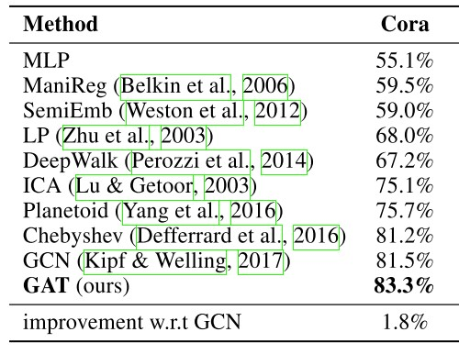
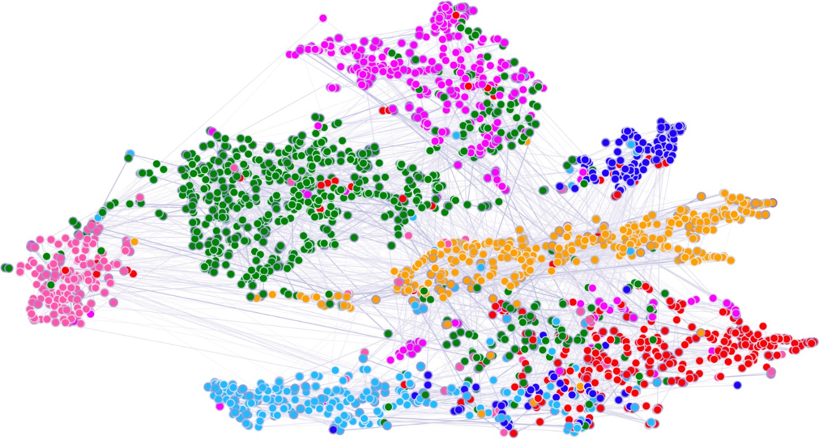

Attention mechanism can be used with many different graph neural network models
In many cases, attention leads to performance gains
t-SNE plot of GAT-based node embeddings:
Node color: 7 publication classes
Edge thickness: Normalized attention coefficients between
nodes 𝑖 and 𝑗, across eight attention heads,

